Slide 1
One-to-One and Recursive Relationships

Slide 2
Chapter Summary
Introduced
Recursive relationships (three types)
Self-referential constraint (Create FKs)
Self-join (SELECT queries)
Different types of recursive relationships
Friend to group (dept-emp, customer to movie, customer-product) (1:M, 1:1)
Single successor (1:1)
Subgroups and hierarchy (M:M)
Social network ties (M:M)

Slide 3
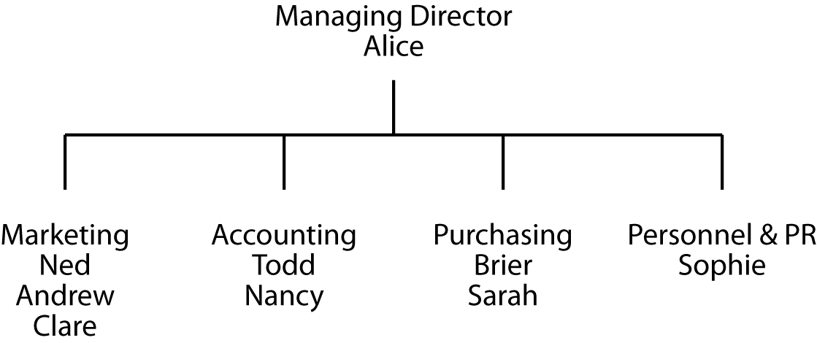
An organization chart
Every structure for presenting data has an underlying data model

Slide 4
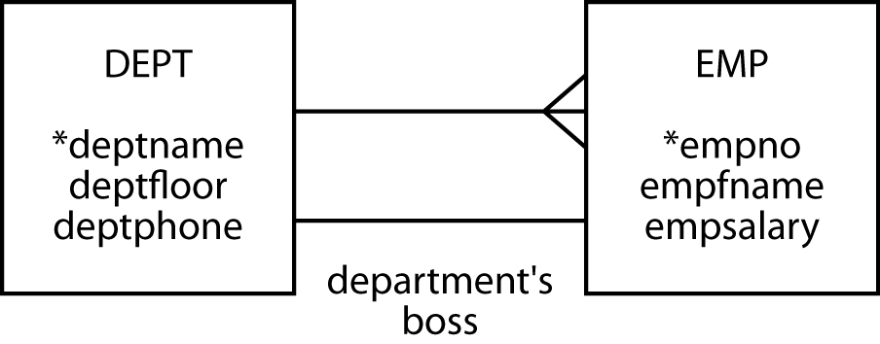
Modeling a 1:1 relationship
1:1 relationship is labeled
A relationship descriptor
Obvious relationships are not labeled

Slide 5
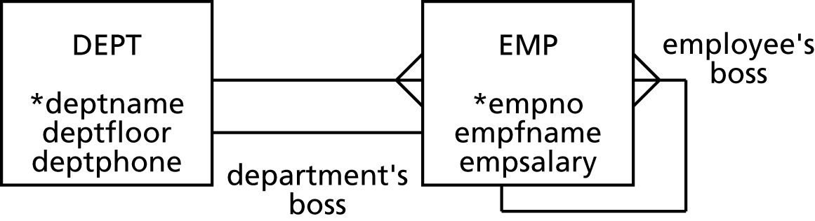
Modeling a recursive relationship
A recursive relationship relates an entity to itself
Label recursive relationships
Assumption:
An employee’s boss need not be in the same Department as the employee.
A Department’s manager need Not always be an employee’s boss.

Slide 6
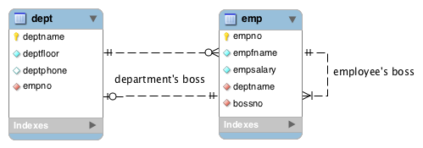
MySQL Workbench

Slide 7
Mapping a 1:1 relationship
Usual rules apply
Where do you put the foreign key?
DEPT
EMP
Both tables

Slide 8
Mapping a recursive relationship
Usual rules
1:m
The entity gets an additional column for the foreign key
Need a name different from the primary key

Slide 9
Results of the mapping
dept
deptname | deptfloor | deptphone | empno
Management | 5 | 2001 | 1
Marketing | 1 | 2002 | 2
Accounting | 4 | 2003 | 5
Purchasing | 4 | 2004 | 7
Personnel & PR | 1 | 2005 | 9
emp
empno | empfname | empsalary | deptname | bossno
1 | Alice | 75000 | Management
2 | Ned | 45000 | Marketing | 1
3 | Andrew | 25000 | Marketing | 2
4 | Clare | 22000 | Marketing | 2
5 | Todd | 38000 | Accounting | 1
6 | Nancy | 22000 | Accounting | 5
7 | Brier | 43000 | Purchasing | 1
8 | Sarah | 56000 | Purchasing | 7
9 | Sophie | 35000 | Personnel & PR | 1

Slide 10
Creating the tables
CREATE TABLE dept (
deptname VARCHAR(15),
deptfloor SMALLINT NOT NULL,
deptphone SMALLINT NOT NULL,
empno SMALLINT NOT NULL,
PRIMARY KEY(deptname));
CREATE TABLE emp (
empno SMALLINT,
empfname VARCHAR(10),
empsalary DECIMAL(7,0),
deptname VARCHAR(15),
bossno SMALLINT,
PRIMARY KEY(empno),
CONSTRAINT fk_belong_dept FOREIGN KEY(deptname)
REFERENCES dept(deptname),
CONSTRAINT fk_has_boss foreign key (bossno)
REFERENCES emp(empno));

Slide 11
Inserting rows
INSERT INTO emp (empno, empfname, empsalary, deptname)
VALUES (1,'Alice',75000,'Management');
INSERT INTO emp VALUES (2,'Ned',45000,'Marketing',1);
INSERT INTO emp VALUES (3,'Andrew',25000,'Marketing',2);
INSERT INTO emp VALUES (4,'Clare',22000,'Marketing',2);
INSERT INTO emp VALUES (5,'Todd',38000,'Accounting',1);
INSERT INTO emp VALUES (6,'Nancy',22000,'Accounting',5);
INSERT INTO emp VALUES (7,'Brier',43000,'Purchasing',1);
INSERT INTO emp VALUES (8,'Sarah',56000,'Purchasing',7);
INSERT INTO emp VALUES (9,'Sophie',35000,'Personnel',1);
Order the INSERTs to avoid referential integrity problems

Slide 12
Querying a 1:1 relationship
List the salary of each department’s boss.
SELECT empfname, deptname, empsalary FROM emp
WHERE empno IN (SELECT empno FROM dept);
empfname | deptname | empsalary
Alice | Management | 75000
Ned | Marketing | 45000
Todd | Accounting | 38000
Brier | Purchasing | 43000
Sophie | Personnel & PR | 35000

Slide 13
Joining a table with itself
Find the salary of Nancy’s boss.
wrk
empno | empfname | empsalary |  | deptname | bossno
1 | Alice | 75000 |  | Management
2 | Ned | 45000 |  | Marketing | 1
3 | Andrew | 25000 |  | Marketing | 2
4 | Clare | 22000 |  | Marketing | 2
5 | Todd | 38000 |  | Accounting | 1
6 | Nancy | 22000 |  | Accounting | 5
7 | Brier | 43000 |  | Purchasing | 1
8 | Sarah | 56000 |  | Purchasing | 7
9 | Sophie | 35000 |  | Personnel & PR | 1
boss
empno | empfname | empsalary |  | deptname | bossno
1 | Alice | 75000 |  | Management
2 | Ned | 45000 |  | Marketing | 1
3 | Andrew | 25000 |  | Marketing | 2
4 | Clare | 22000 |  | Marketing | 2
5 | Todd | 38000 |  | Accounting | 1
6 | Nancy | 22000 |  | Accounting | 5
7 | Brier | 43000 |  | Purchasing | 1
8 | Sarah | 56000 |  | Purchasing | 7
9 | Sophie | 35000 |  | Personnel & PR | 1

Slide 14
Querying a recursive relationship
Find the salary of Nancy’s boss.
SELECT wrk.empfname, wrk.empsalary, boss.empfname, boss.empsalary
FROM emp wrk, emp boss
WHERE wrk.empfname = 'Nancy'
AND wrk.bossno = boss.empno;
wrk |  |  |  |  |  | boss
empno | empfname | empsalary | deptname |  | bossno | empno | empfname | empsalary | deptname |  | bossno
2 | Ned | 45,000 | Marketing |  | 1 | 1 | Alice | 75,000 | Management
3 | Andrew | 25,000 | Marketing |  | 2 | 2 | Ned | 45,000 | Marketing |  | 1
4 | Clare | 22,000 | Marketing |  | 2 | 2 | Ned | 45,000 | Marketing |  | 1
5 | Todd | 38,000 | Accounting |  | 1 | 1 | Alice | 75,000 | Management
6 | Nancy | 22,000 | Accounting |  | 5 | 5 | Todd | 38,000 | Accounting |  | 1
7 | Brier | 43,000 | Purchasing |  | 1 | 1 | Alice | 75,000 | Management
8 | Sarah | 56,000 | Purchasing |  | 7 | 7 | Brier | 43,000 | Purchasing |  | 1
9 | Sophie | 35,000 | Personnel & PR |  | 1 | 1 | Alice | 75,000 | Management
wrk.empfname | wrk.empsalary | boss.empfname | boss.empsalary
Nancy | 22000 | Todd | 3800

Slide 15
Querying a recursive relationship
Find the names of employees who earn more than their boss.
SELECT wrk.empfname
FROM emp wrk, emp boss
WHERE wrk.bossno = boss.empno
AND wrk.empsalary > boss.empsalary;
wrk |  |  |  |  |  | boss
empno | empfname | empsalary | deptname |  | bossno | empno | empfname | empsalary | deptname |  | bossno
2 | Ned | 45,000 | Marketing |  | 1 | 1 | Alice | 75,000 | Management
3 | Andrew | 25,000 | Marketing |  | 2 | 2 | Ned | 45,000 | Marketing |  | 1
4 | Clare | 22,000 | Marketing |  | 2 | 2 | Ned | 45,000 | Marketing |  | 1
5 | Todd | 38,000 | Accounting |  | 1 | 1 | Alice | 75,000 | Management
6 | Nancy | 22,000 | Accounting |  | 5 | 5 | Todd | 38,000 | Accounting |  | 1
7 | Brier | 43,000 | Purchasing |  | 1 | 1 | Alice | 75,000 | Management
8 | Sarah | 56,000 | Purchasing |  | 7 | 7 | Brier | 43,000 | Purchasing |  | 1
9 | Sophie | 35,000 | Personnel & PR |  | 1 | 1 | Alice | 75,000 | Management
empfname
Sarah

Slide 16
Class Exercise 1
Using the Dept-Emp tables created in the previous slides, find the names of employees in the same department as their boss.
Study the Employee database on my MySQL server and map the recursive relationships implemented in it. (this DB is different from the one above).

Slide 17
Class Exercise 1 (cont’d)
Several Olympic events are team sports (e.g., basketball, relays) and some involve a pair of athletes (e.g., kayaking, rowing, beach volleyball)
A team can have a captain
A country has a flag bearer
There can be some husband and wife pairs at a games (e.g., Jared Tallent and Claire Woods from Australia)
Draw a data model to record these details

Slide 18
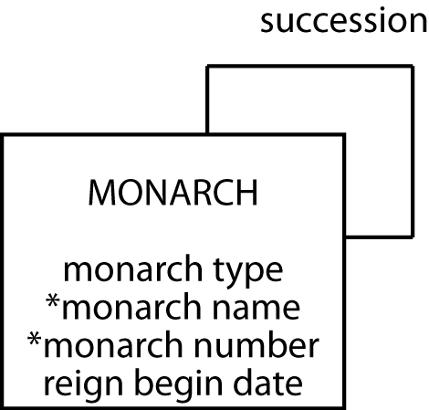
Modeling a 1:1 recursive relationship
The English monarchy

Slide 19
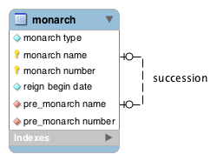
MySQL Workbench

Slide 20
Mapping a 1:1 recursive relationship
monarch
montype | monname | monnum | rgnbeg | premonname | premonnum
Queen | Victoria | I | 1837/6/20 | William | IV
King | Edward | VII | 1901/1/22 | Victoria | I
King | George | V | 1910/5/6 | Edward | VII
King | Edward | VIII | 1936/1/20 | George | V
King | George | VI | 1936/12/11 | Edward | VIII
Queen | Elizabeth | II | 1952/2/6 | George | VI

Slide 21
Creating the table
CREATE TABLE monarch (
montype VARCHAR(5),
monname VARCHAR(15) NOT NULL,
monnum VARCHAR(5) NOT NULL,
rgnbeg DATE,
premonname VARCHAR(15),
premonnum VARCHAR(5),
PRIMARY KEY(monname,monnum),
CONSTRAINT fk_monarch
FOREIGN KEY (premonname, premonnum)
REFERENCES monarch(monname, monnum));

Slide 22
Inserting rows
INSERT INTO monarch (montype,monname, monnum,rgnbeg)
VALUES ('King','William','IV','1830-06-26');
INSERT INTO monarch
VALUES ('Queen','Victoria','I','1837-06-20','William','IV');
INSERT INTO monarch
VALUES ('King','Edward','VII','1901-01-22','Victoria','I');
INSERT INTO monarch
VALUES ('King','George','V','1910-05-06','Edward','VII');
INSERT INTO monarch
VALUES ('King','Edward','VIII','1936-01-20','George','V');
INSERT INTO monarch
VALUES ('King','George','VI','1936-12-11','Edward','VIII');
INSERT INTO monarch
VALUES 'Queen','Elizabeth','II','1952-02-06','George','VI');

Slide 23
Querying a 1:1 recursive relationship
Who preceded Elizabeth II?
SELECT premonname, premonnum FROM monarch
WHERE monname = 'Elizabeth' and monnum = 'II';
premonname | premonnum
George | VI

Slide 24
Querying a 1:1 recursive relationship
Was Elizabeth II's predecessor a king or queen?
SELECT pre.montype FROM monarch cur, monarch pre
WHERE cur.premonname = pre.monname
AND cur.premonnum = pre.monnum
AND cur.monname = 'Elizabeth'
AND cur.monnum = 'II';
montype
King

Slide 25
Querying a 1:1 recursive relationship
List the kings and queens of England in ascending chronological order.
SELECT montype, monname, monnum, rgnbeg
FROM monarch ORDER BY rgnbeg;
montype | monname | monnum | rgnbeg
Queen | Victoria | I | 1837-06-20
King | Edward | VII | 1901-01-22
King | George | V | 1910-05-06
King | Edward | VIII | 1936-01-20
King | George | VI | 1936-12-11
Queen | Elizabeth | II | 1952-02-06

Slide 26
Class Exercise 2
Solve Q3 from textbook exercises.
Design a database to record details of all Olympic cities
Recognize that a city can host an Olympics more than once, though a particular Olympics is only in one city at a time
Recognize that each Olympics has only predecessor and successor

Slide 27
Class Exercise 2 (cont’d)
Add details of the last three summer Olympics’ cities
Use SQL to determine which city was the host before London

Slide 28
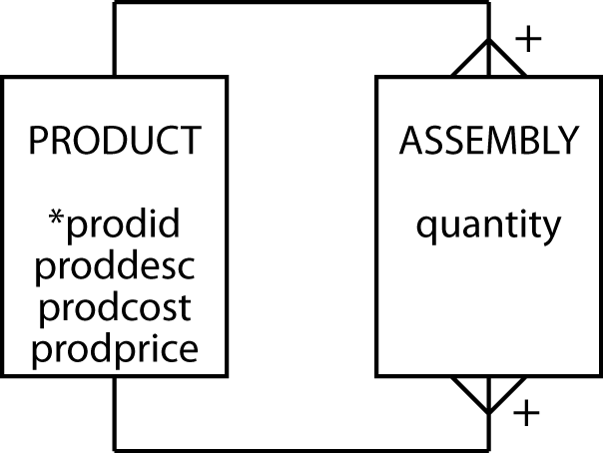
Modeling an m:m recursive relationship
Bill of materials (BOM) problem
A product can appear as part of many other products and can be made up of many products
Examples: Manufacturing, Service-costing

Slide 29
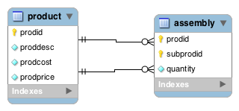
Modeling an m:m recursive relationship

Slide 30
Mapping an m:m recursive relationship
product
prodid | proddesc | prodcost | prodprice
1000 | Animal photography kit |  | 725
101 | Camera | 150 | 300
102 | Camera case | 10 | 15
103 | 70-210 zoom lens | 125 | 200
104 | 28-85 zoom lens | 115 | 185
105 | Photographer’s vest | 25 | 40
106 | Lens cleaning cloth | 1 | 1.25
107 | Tripod | 35 | 45
108 | 16 GB SDHC memory card | 30 | 30
assembly
quantity | prodid | subprodid
1 | 1000 | 101
1 | 1000 | 102
1 | 1000 | 103
1 | 1000 | 104
1 | 1000 | 105
2 | 1000 | 106
1 | 1000 | 107
4 | 1000 | 108

Slide 31
Creating the tables
CREATE TABLE product (
prodid INTEGER,
proddesc VARCHAR(30),
prodcost DECIMAL(9,2),
prodprice DECIMAL(9,2),
PRIMARY KEY(prodid));
CREATE TABLE assembly (
quantity INTEGER NOT NULL,
prodid INTEGER,
subprodid INTEGER,
PRIMARY KEY(prodid, subprodid),
CONSTRAINT fk_assembly_product FOREIGN KEY(prodid)
REFERENCES product(prodid),
CONSTRAINT fk_assembly_subproduct FOREIGN KEY(subprodid)
REFERENCES product (prodid));

Slide 32
Querying an m:m recursive relationship
List the product identifier of each component of the animal photography kit.
SELECT subprodid FROM product, assembly
WHERE proddesc = 'Animal photography kit'
AND product.prodid = assembly.prodid;
subprodid
101
106
107
105
104
103
102
108

Slide 33
Querying an m:m recursive relationship
List the product description and cost of each component of the animal photography kit.
SELECT proddesc, prodcost FROM product
WHERE prodid IN
(SELECT subprodid FROM product, assembly
WHERE proddesc = 'Animal photography kit'
AND product.prodid = assembly.prodid);
proddesc | prodcost
Camera | 150.00
Camera case | 10.00
70-210 zoom lens | 125.00
28-85 zoom lens | 115.00
Photographer’s vest | 25.00
Lens cleaning cloth | 1.00
Tripod | 35.00
16 GB SDHC memory card | 30.00

Slide 34
Class Exercise 3
Model the following situations
Course prerequisites
A matrix organization where a person can report to multiple people

Slide 35
Class Exercise 3 (cont’d)
In a round-robin tournament, each contestant meets all other contestants in turn
In the Olympics, it is common for an event with a large pool of contestants to be broken into groups, with a round-robin tournament in each group to determine who advances from the group to the next level
Design a data model to record details of a round-robin competition

Slide 36
Class Exercise 3 (cont’d)
Insert data in the round-robin database for the 2012 Football (Soccer) competition for Group A, with four teams
See http://www.london2012.com/football/schedule-and-results/
How many ties were there in Group A?
Use the ISO two-character country code to identify countries
http://en.wikipedia.org/wiki/ISO_3166-1_alpha-2

Slide 37
Class Exercise 3 (cont’d)
Model a diagram showing the evolution of programming languages

Slide 38
Social Network Data
Basic structure:
A user friends many ‘users’
The same user can be friended by many users
Userid
Username
Gender
age

Slide 39
Class Exercise 4
Model the basic model for the social network data in
Facebook
Yelp
LinkedIn: Find the total number of 2nd degree connections in your network - (Connections of connections)

Slide 40
Application
DB: bigpvfc
Find the 3 most similar pairs of customers in terms of the number of similar products purchased.
Segmentation: Which states (pairs) are most similar in terms of their purchases?
DB: sakila
Find all the 2nd degree connections of actor Julia Barrymore, based on the co-acting network.
DB: text (tables product, assembly)
Write a query to calculate the total profit of all “level 2 products”. The query result should have three columns: the product ID (level product), its price and the total cost. (5 points).

Slide 41
Chapter Summary
Introduced
Recursive relationships (three types)
Self-referential constraint (Create FKs)
Self-join (SELECT queries)
Different types of recursive relationships
Friend to group (dept-emp, customer to movie, customer-product) (1:M, 1:1)
Single successor (1:1)
Subgroups and hierarchy (M:M)
Social network ties (M:M)

Slide 42
Next Week
Complete homework assignment
Midterm exam
See Modules → Midterm Exam for format
Practice: Textbook exercises and textbook website material + Homework

